Slide 1

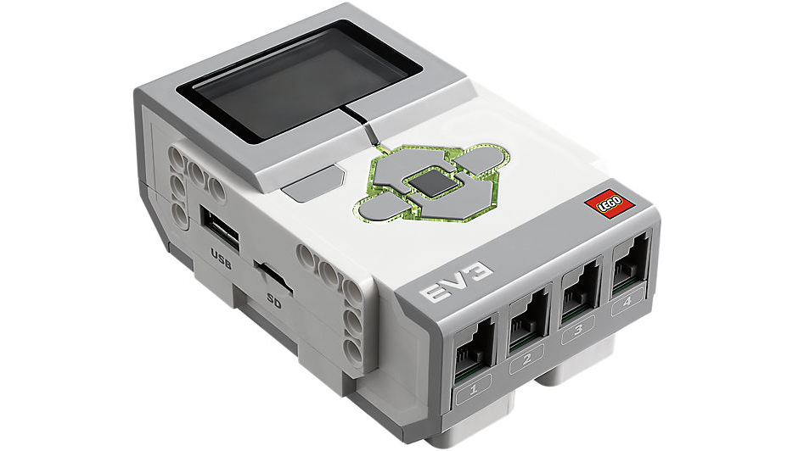
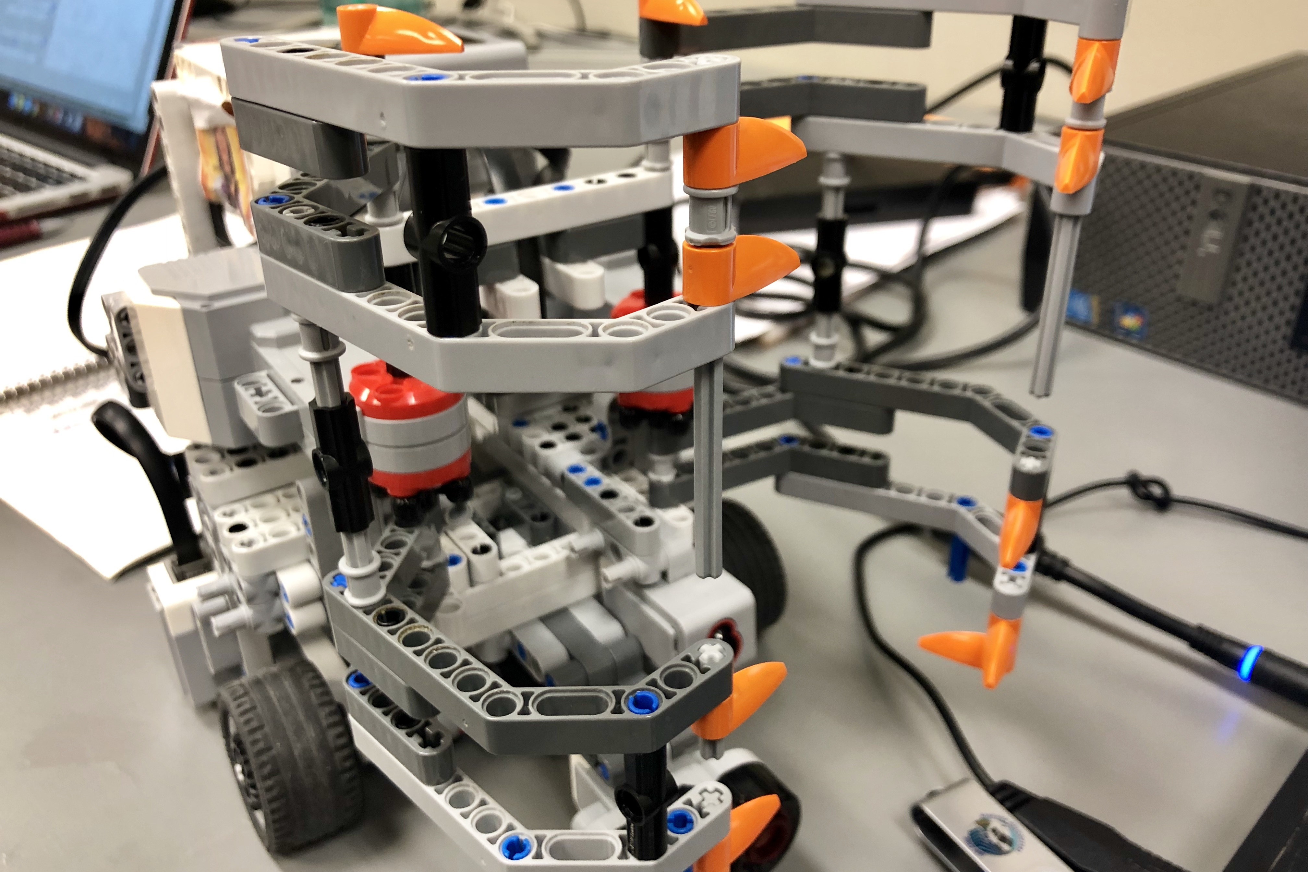
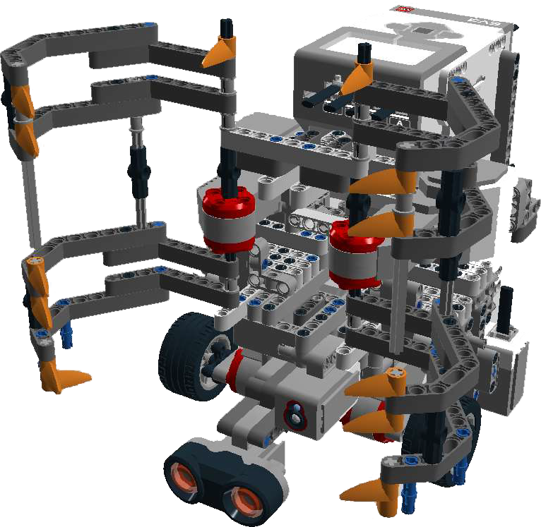
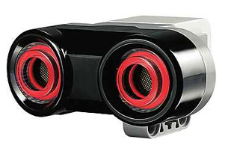
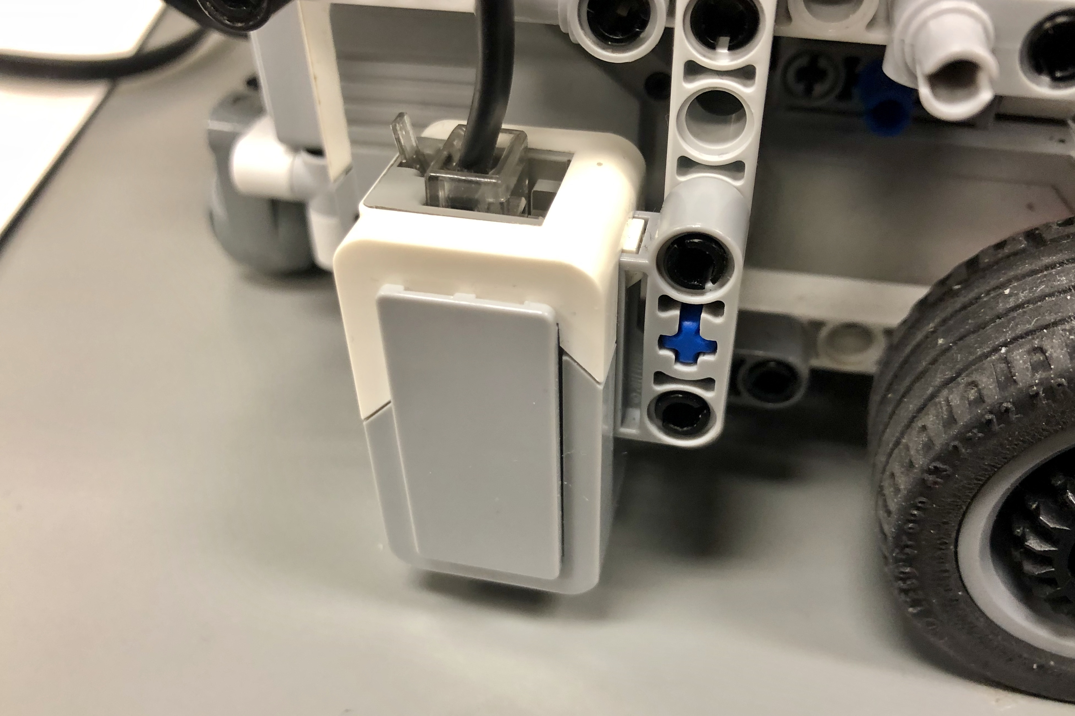
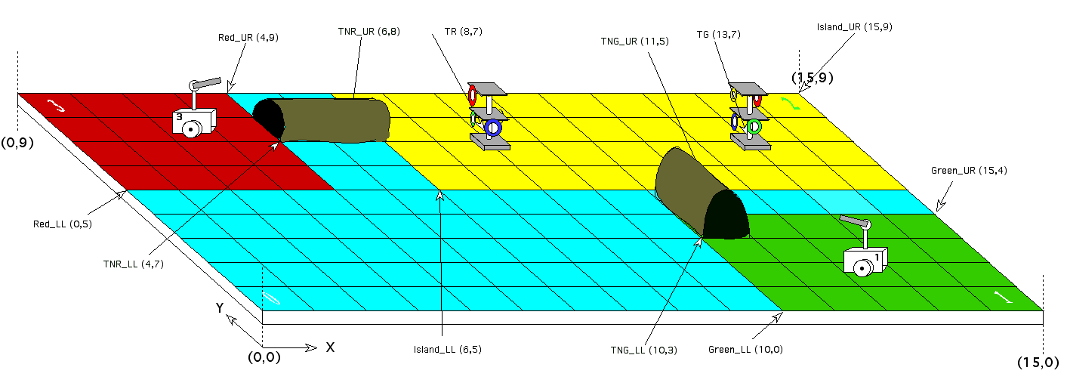
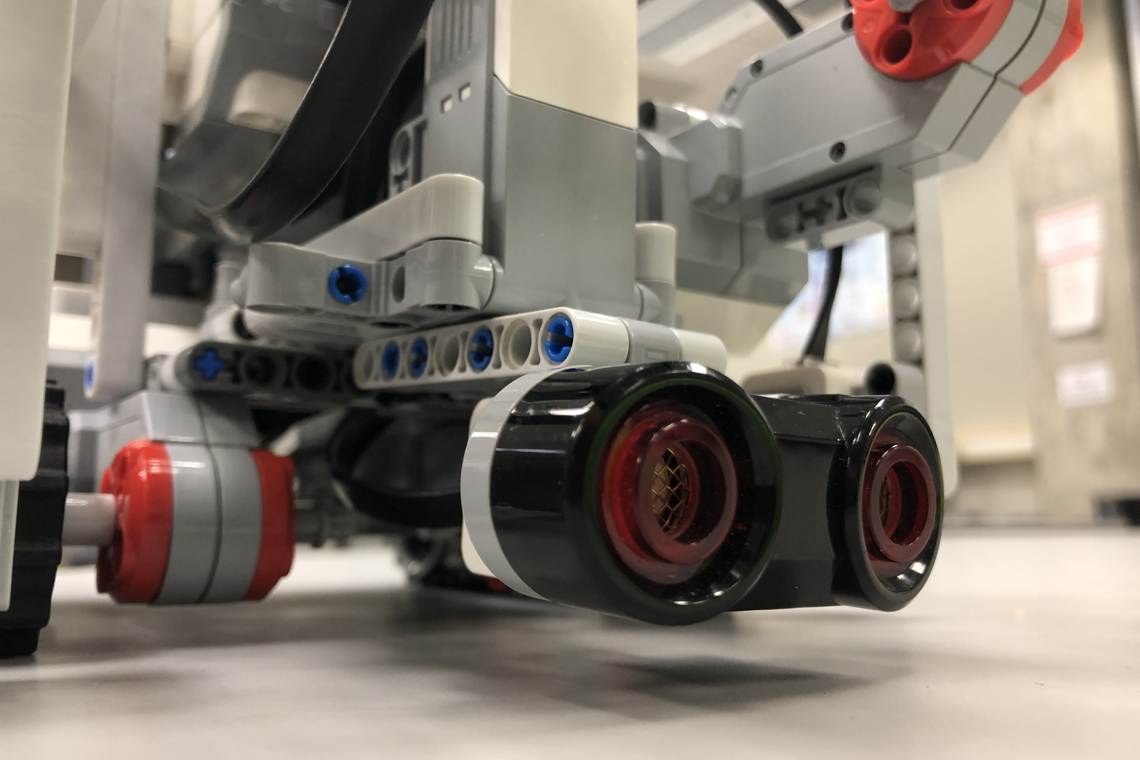
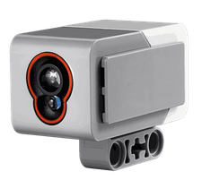
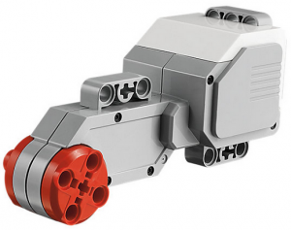
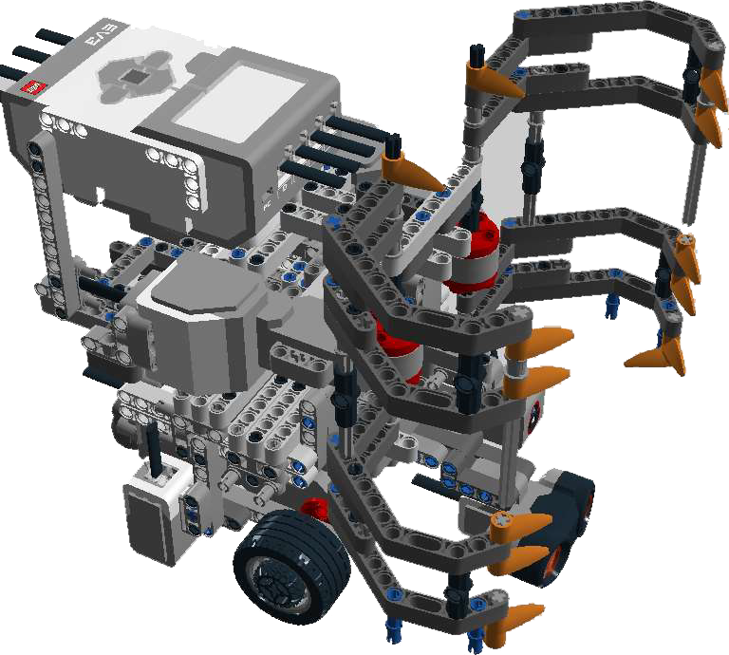
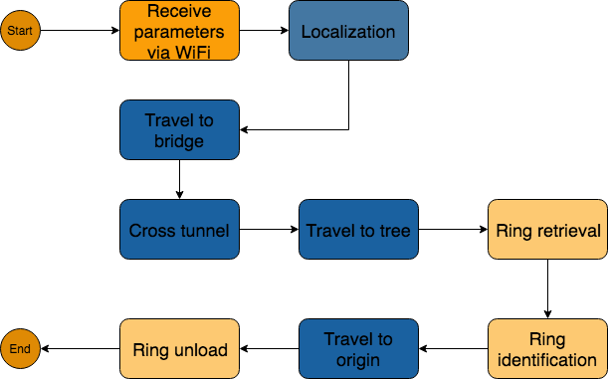
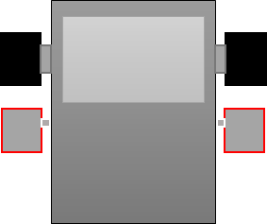





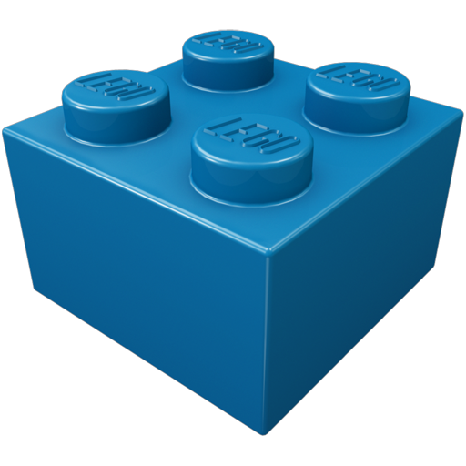





TEAM 17 – MADMAX
Design Principles and Methods ECSE 211 – Fall 2018
Overview
Hardware Design
REQUIREMENTS
Localization | The robot must be able to determine which starting corner it is in as well as localize itself to the intersection of the first corner, with proper orientation, regardless of the corner
Navigation/ correction | The robot must accurately move along the gridlines, iteratively correcting to the mandatory coordinates provided by the WIFI class
Retrieve ring | The robot must have a retrieval and holding mechanism to acquire and transport the ring
PURPOSE
The overall purpose of the project was to assemble and develop an autonomous robot capable of self-localizing, situating and navigating itself through a tunnel, in prescribed area limits to a tree containing multiple rings of varying colours which it can detect, retrieve and return to its initial starting point without any human assistance.
CONSTRAINTS
There are 4 possible starting corners | There are 2 ring trees, only one for our robot
There are 2 different orientations of the tunnel & it may overlap the starting zone | The ring tree has 4 rings, possibly at different heights
The starting corners and neutral zone are of varying sizes | Localization must occur in 30 seconds
The board is 15x9 tiles, each of 30.48cm in dimension | The entire retrieval must occur in 5 minutes
The tunnel’s circumference is 11.6cm and narrower at the bottom (8.4cm) in a 2x1 or a 1x1 size | The robot must beep after certain operations and in specific patterns for specific ring colours
The robot must cross the tunnel with a cover of fixed size | There are 4 sensor ports and 4 motor ports on the brick
Claws for grabbing rings
Two EV3 motors for claws moving
x1
x1
x3
One ultrasonic sensor for localization
Two light sensors for navigation correction
Team
x4
One light sensors for ring color detection
Nada Shoukry, Project Manager
Maxime Cardinal, Software Team Lead
Spencer Handfield, Documentation Manager
Yi Zhu, Hardware Team Lead
Ameer Ibrahim, Testing Manager
Irmak Pakis, Software Team Member
Software Design Process
Budget
Preliminary Design
Localization design
Travelling design
Ring retrieval design
Modifications & improvement
1. Software architecture design and class diagram design
2. Reuse of code from Lab 4 and improvement of the overall localization
3. Implementation of travelling with correction
4. Reuse of code from Lab5 for color detection and implementation of the claws’ control
5. Modifications of software architecture and improvement of localization, line detection & travelling
Position Correction
Testing Process
Preliminary Testing Phase: Testing of individual hardware capabilities
Intermediate Testing phase: Functional testing of initial software version
Beta Testing Phase: Extensive testing of software methods individually
Integration Testing Phase: Testing of the integration of software methods
Ultrasonic Sensor Test
Motors Test.
travelToBridge() method Test
travelThroughBridge() & travelToRingSet Test
Localization Test
Localization test
travelToBridge() Test
ringRetrieval() Test
Navigation Integration test
Integration test 1
Integration test 2
1. A sensor detects a line.
2. Turn until the other sensor detects a line.
3. Stop motors. Orientation is corrected.
Localization:
Success rate of 82.5%
Average run time of 28.2 seconds.
Navigation:
Success rate of 53%
Average run time of 3 minutes & 32.9 seconds.
Ring Retrival:
Success rate of 97%.
Color identification 85% success rate.
Tools

